Slide 1

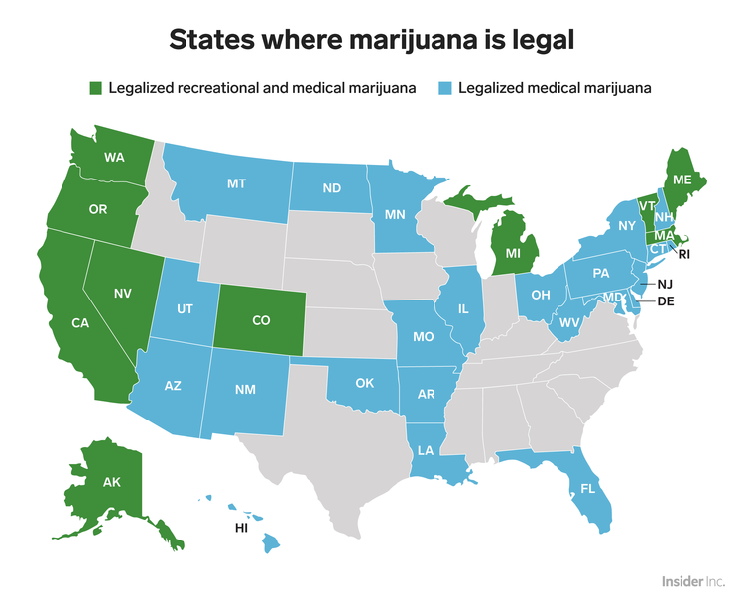
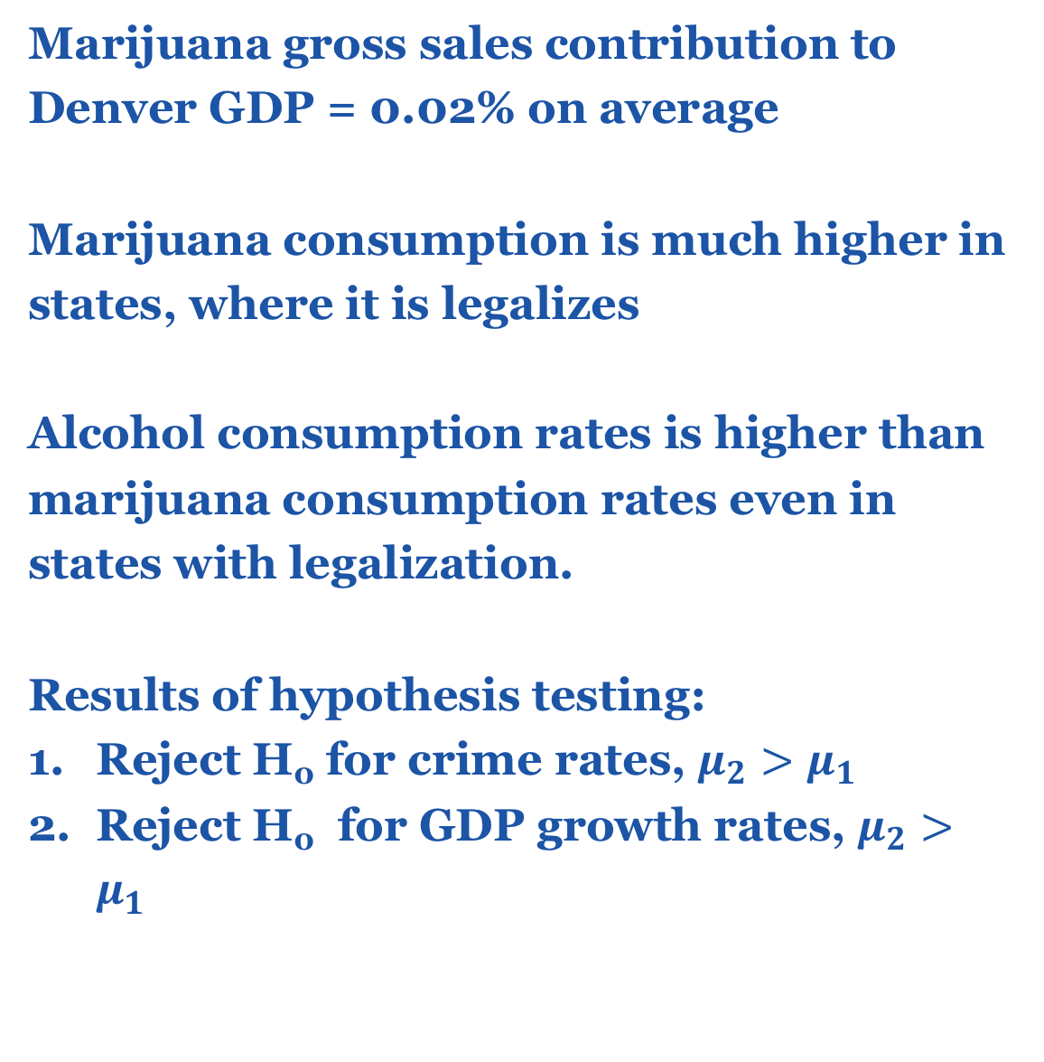
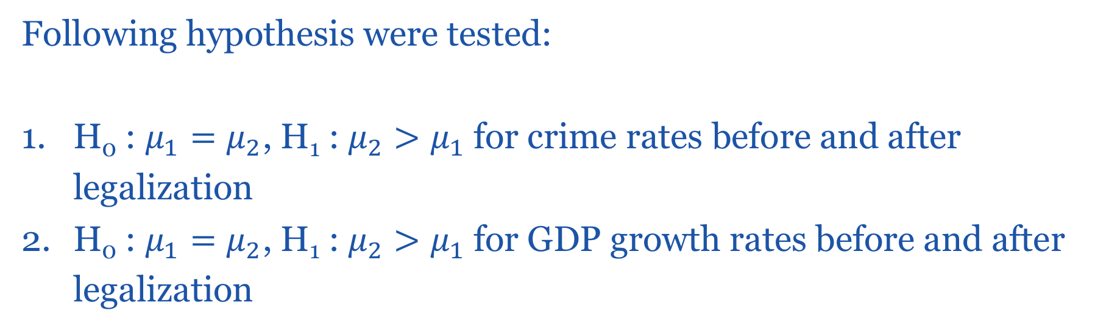
Marijuana legalization impact,
USA
R. Stepaniuk
Introduction
1
Methodology
2
As more countries in the world legalize marijuana, more popular become debates about marijuana impact and further legalization. More and more people starts to support marijuana legalization. It seems like it might have a positive impact on economy, but what about the impact on people health and crime rates?
The research consist of analysis of marijuana impact after legalization in USA.
Support of legalization in US by years
The methodology implies the use of statistical tools for hypothesis testing and data processing approaches:
1st : Collect and rebuild data for further analysis
2nd: Analyze data about economic conditions, health and crime rates before and after legalization using laws of large numbers, t-, z-test
Experiment Setup
3
The experiment setup involves:
Data from the real world before legalization of marijuana
Data from the real world after legalization of marijuana
Analyzing changes in crime rates
Analyzing marijuana consumption changes
Analyzing changes of economics
The purpose of the experiment is to identify the impact of marijuana legalization on different life spheres using real world data.
States where marijuana is legal
Marijuana usage by age in US in 2015
In the particular case, the crime rates and economics data is collected by Denver government, Colorado, USA with legalized marijuana from 2014. Data about marijuana usage includes states with legalized marijuana and not legalized. Data about GDP growth rates were collected from different sources.
The research includes analysis in marijuana consumption and alcohol consumption by years and by categories, for example: “First time usage”, “Once per month usage” etc.
Following hypothesis were tested:
H₀ : $μ_{1}=μ_{2}$, H₁ : $μ_{2}>μ_{1}$for crime rates before and after legalization
H₀ : $μ_{1}=μ_{2}$, H₁ : $μ_{2}>μ_{1}$for GDP growth rates before and after legalization
Comparison of marijuana and alcohol usage by age in US in 2015
Results
4
Conclusions
5
Marijuana gross sales contribution to Denver GDP = 0.02% on average
Marijuana consumption is much higher in states, where it is legalizes
Alcohol consumption rates is higher than marijuana consumption rates even in states with legalization.
Results of hypothesis testing:
Reject H₀ for crime rates, $μ_{2}>μ_{1}$
Reject H₀ for GDP growth rates, $μ_{2}>μ_{1}$
Statistic of crime activity in Denver by years
From results of research, marijuana legalization helps on moving from shade a part of economy.
In the same time analysis of collected data showed that marijuana legalization have a negative impact on crime rates and leads to more volume of consumption of marijuana even among children.
Based on the research, we shouldn’t legalize marijuana, but it is better to proceed with further analysis and wait until more data available.
Conclusions
Applied Sciences Faculty, Ukrainian Catholic University, Lviv, Ukraine (r.stepaniuk@ucu.edu.ua)

